Slide 1
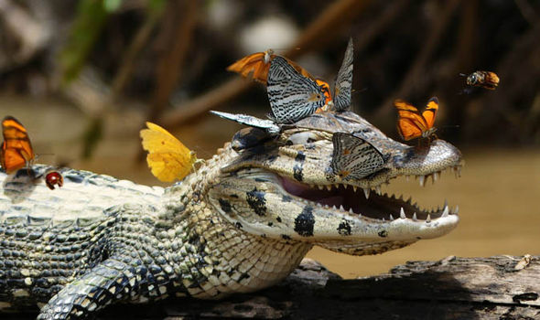
Species Interactions

Slide 2
Learning Goals
Use the competitive exclusion principle to predict the outcome of two species competing for the same resource

Slide 3
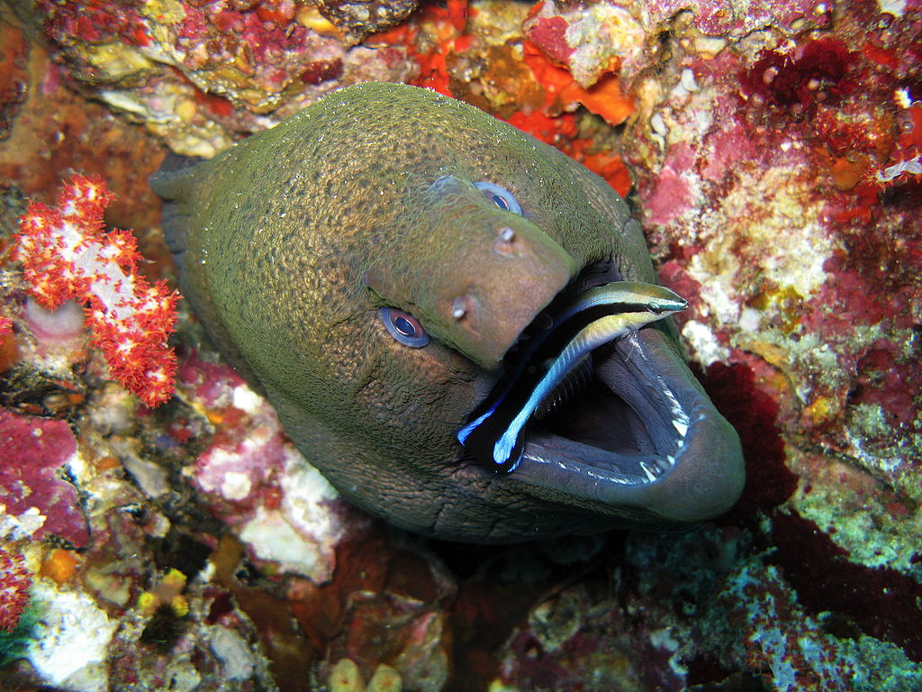
This is not predation
The smaller fish and the eel have an arrangement
The smaller fish removes parasites from the eel’s mouth
The eel does not eat the smaller fish, but will eat other fish that come near
Species interactions are complex and fascinating

Slide 4
Community interactions
Interspecific interactions - interactions involving different species
Some interactions are negative
Competition (- -)
Exploitative interactions (+ -)
Predation, Herbivory, Parasitism
Postive interactions
mutualism (+ +), commensalism (+ 0)

Slide 5
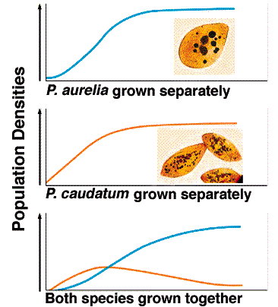
Competition
Two species compete for a resource that limits the survival and reproduction of each species
Gause’s Competitive exclusion principle - species competing for the same resource cannot coexist indefinitely in the same space

Slide 6
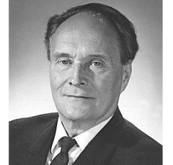
Who was Gause?
Born in 1910 in Moscow
His research competitive exclusion was his honors thesis while an undergraduate at University of Moscow
When on to discover a new antibiotic, and research antibiotics and anti-tumor drugs

Slide 7
Species Interactions

Slide 8
Learning Goals
Explain the how resource partitioning allows species with similar niches to coexist, and explain how it is different than character displacement

Slide 9
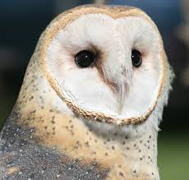
Ecological niche
Ecological niche - the set of biotic and abiotic factors a species uses in its environment
Barn owl niche consists of: temperature range it tolerates, kinds of trees it perches on, time of day it is active, sizes and kinds of prey it consumes, etc.

Slide 10
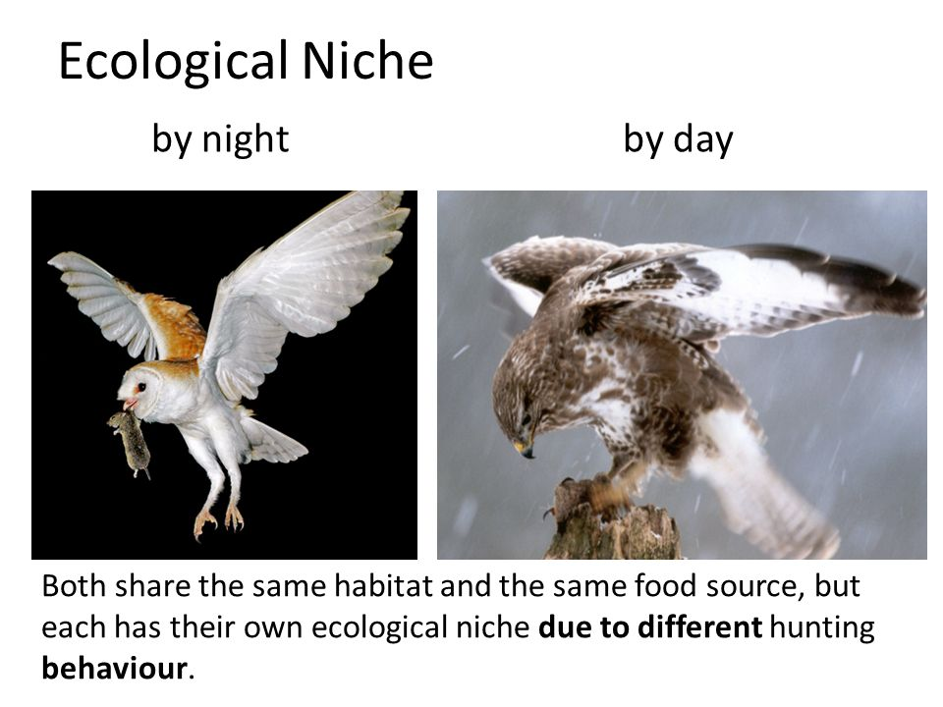

Slide 11
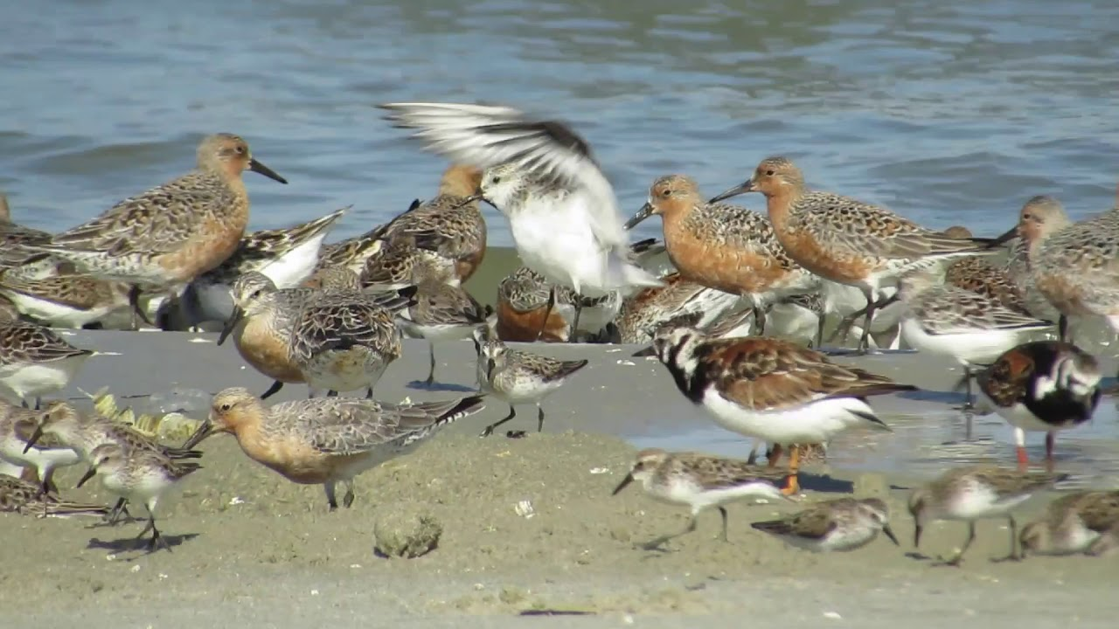
Resource partitioning
Differentiation of niches that enables similar species to coexist
Resource partitioning is the division of limited resources by species to help avoid competition in an ecological niche

Slide 12
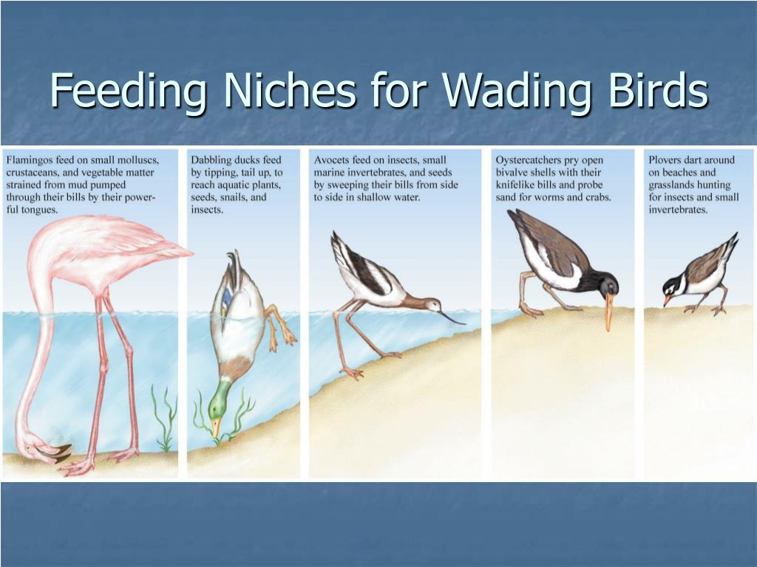

Slide 13
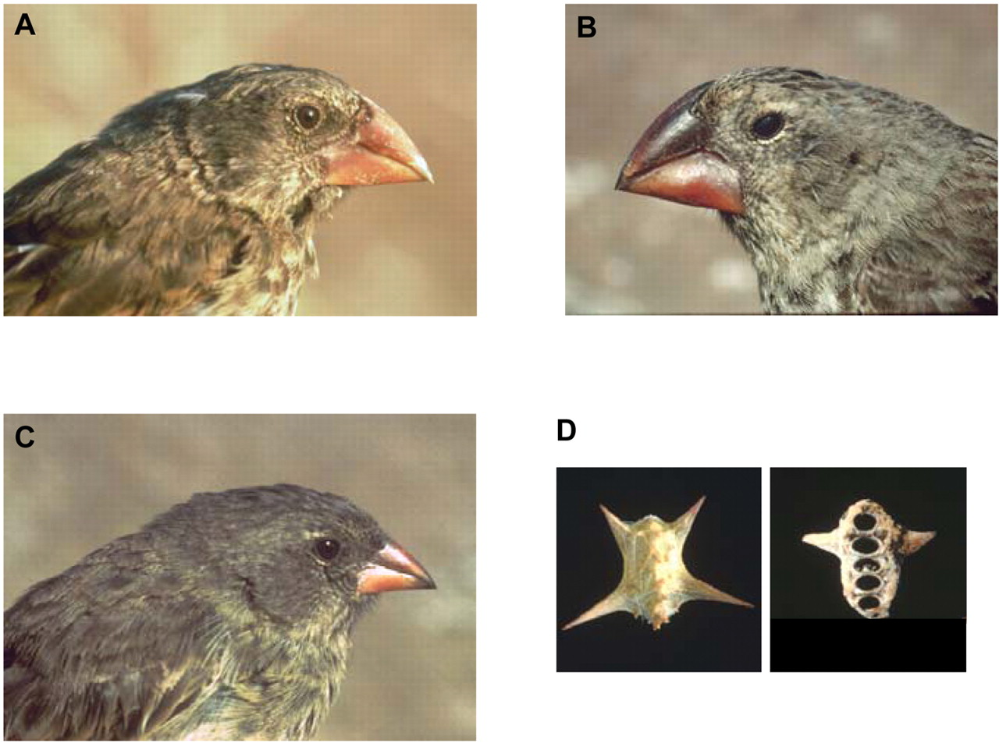
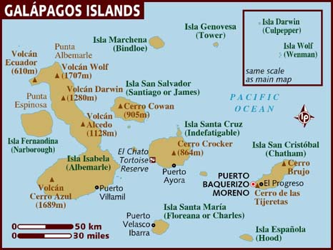
Character displacement
Over several generations, resource partitioning can lead to character displacement
Character displacement- Divergence in species traits, driven by natural selection, when two species come into competition

Slide 14
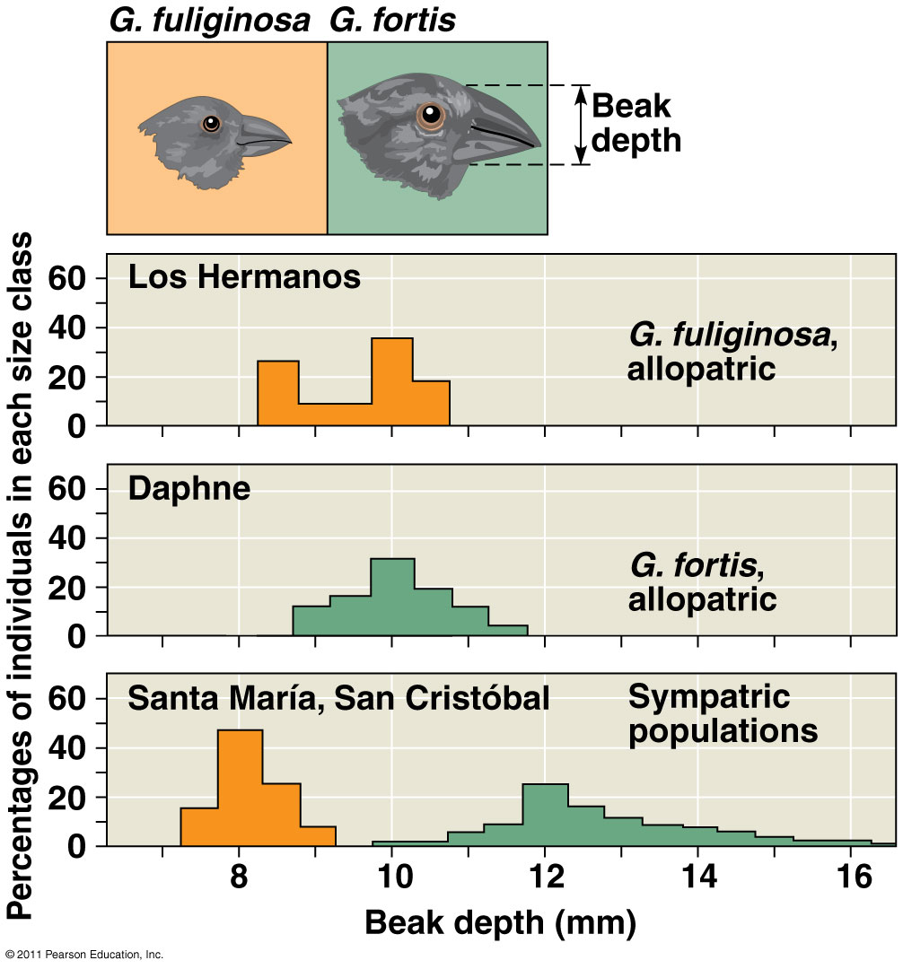
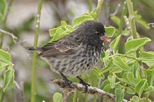
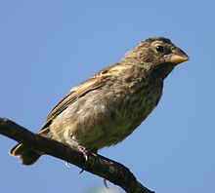
Character displacement in two species of Darwin’s finches

Slide 15
Species Interactions

Slide 16
Learning Goals
Describe similarities in defensive adaptations of animals and plants
Explain why predation differs from herbivory and parasitism

Slide 17
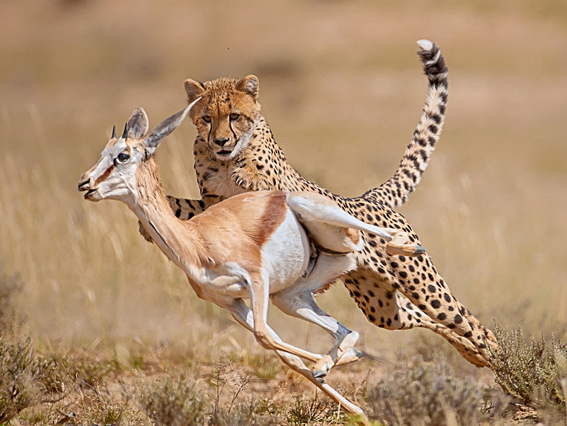
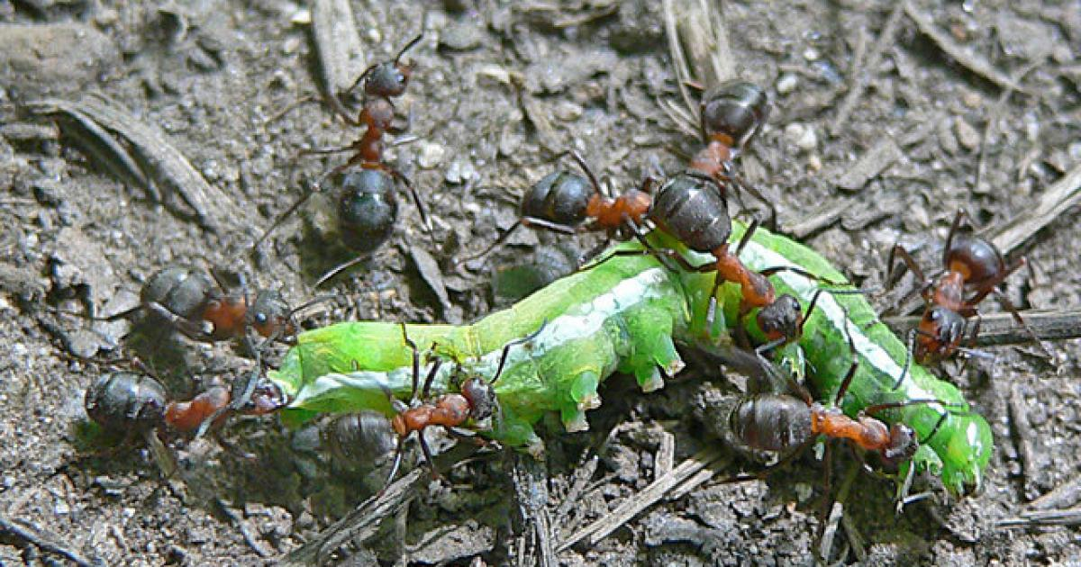
Predation
Predation - one species, the predator, eats and kills the other, the prey species
Adaptations of predators and prey are shaped by natural selection

Slide 18
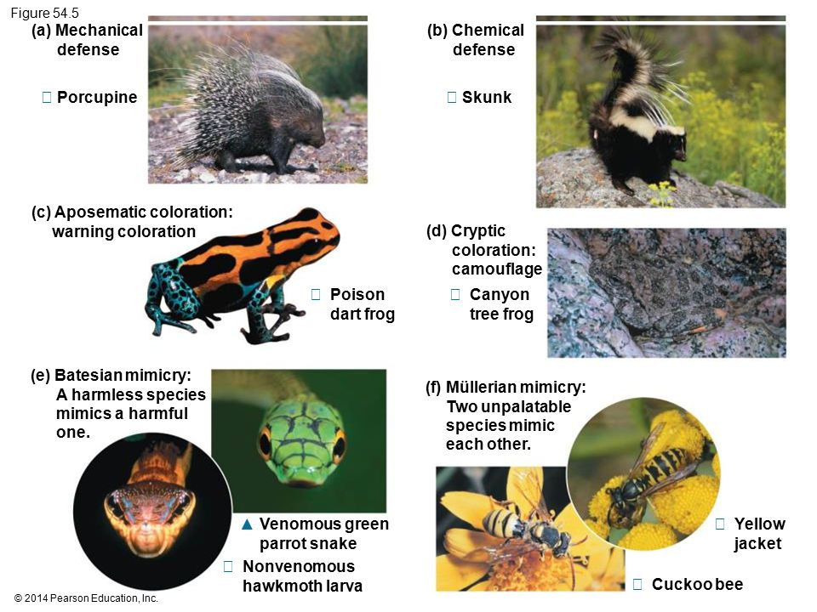

Slide 19
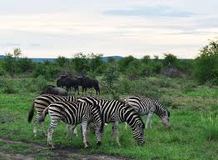
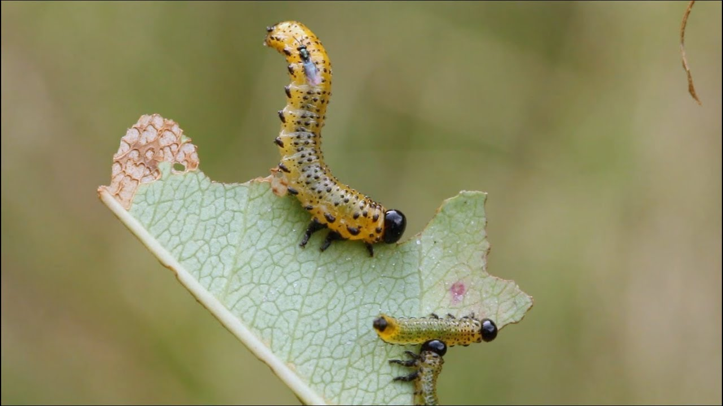
Herbivory
Herbivory - one species, the herbivore eats parts of a plant or algae
Adaptations of herbivores and and plants are shaped by natural selection

Slide 20
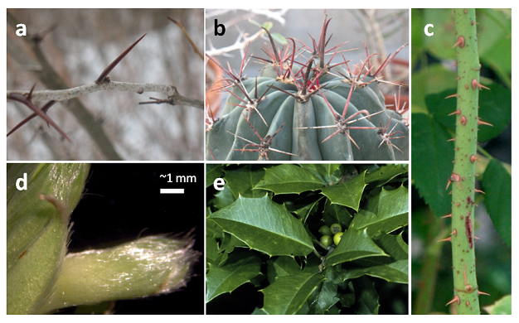
Plant defenses
Mechanical defenses - spines, thorns, and other structures to defer feeding

Slide 21
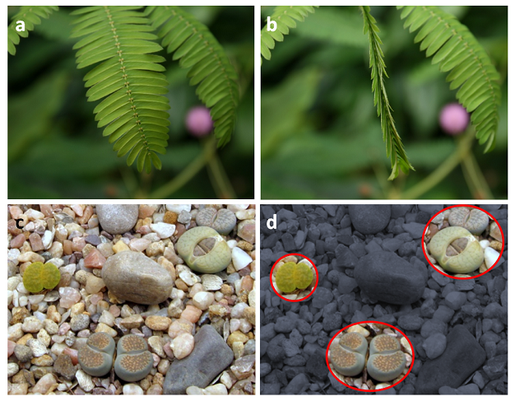
Plant defenses
Crypsis - plants mimic dead leaves (sensitive plant) or rely on camouflage (Lithops)

Slide 22
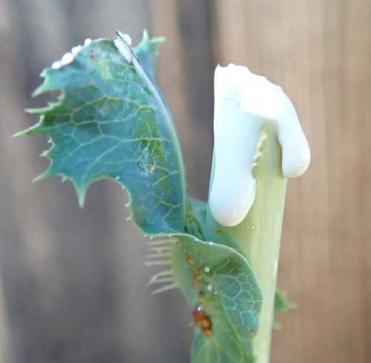
Plant defenses
Chemical defenses - plants produce chemical compounds that are toxic to herbivores

Slide 23
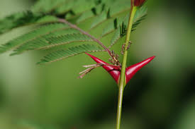
Plant defenses
Indirect defenses - herbivores are attacked, or harassed by predators like ants and wasps

Slide 24
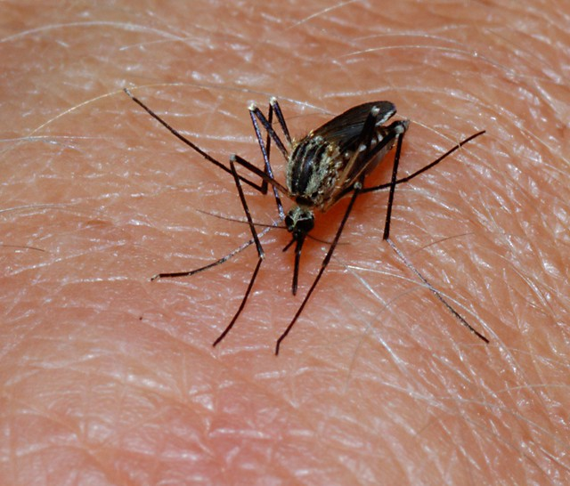
Parasitism
The parasite, derives its nutrition from a host, which is harmed in the process
Ectoparasites v. Endoparasites

Slide 25
Species Interactions

Slide 26
Learning Goals
Differentiate between mutualism and commensalism
Identify and explain key features of the ant-acacia mutualism

Slide 27
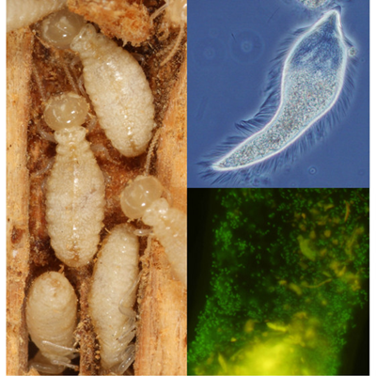
Mutualism
Interaction in which both species benefit from the association
We have seen several cases in this class so far

Slide 28
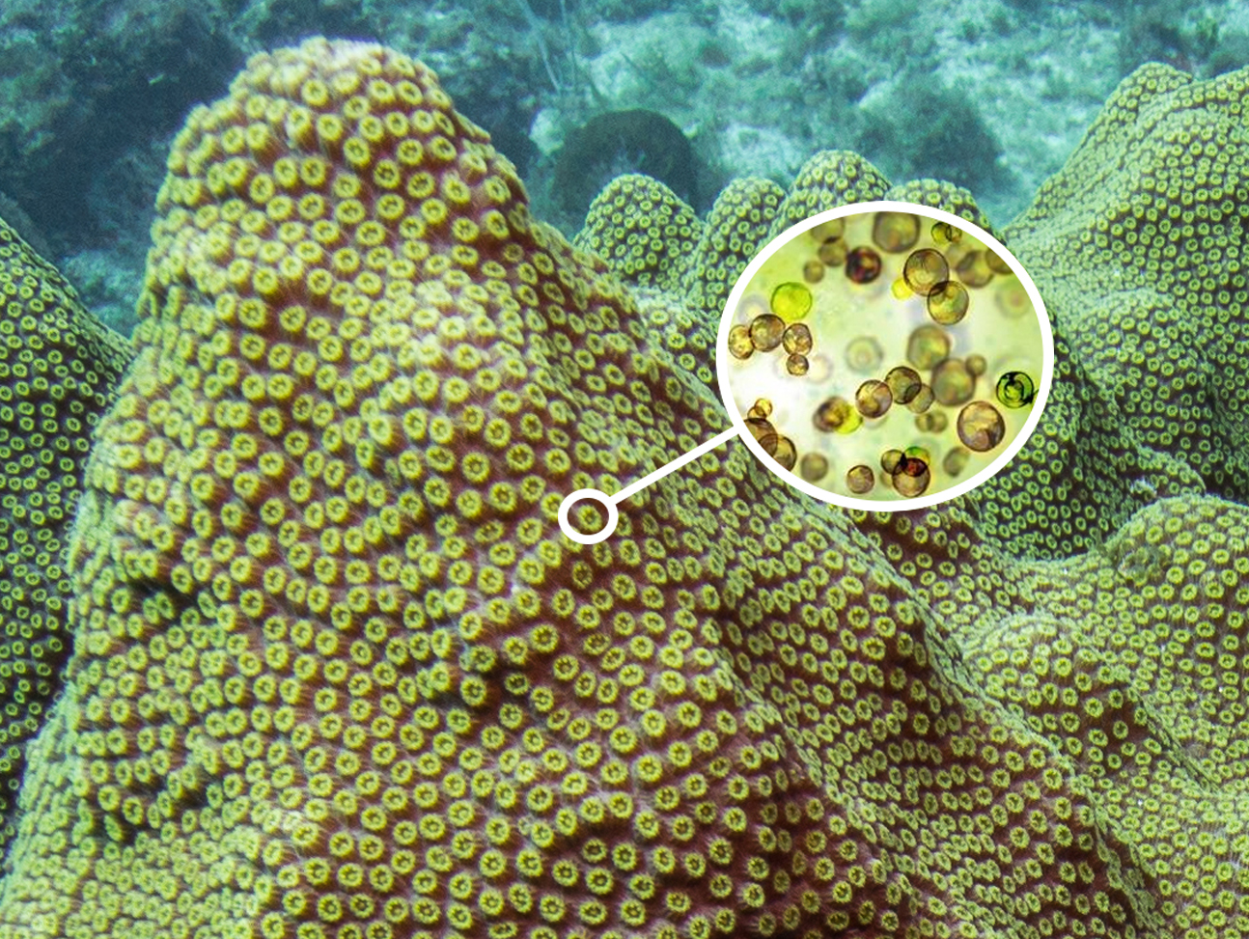

Slide 29
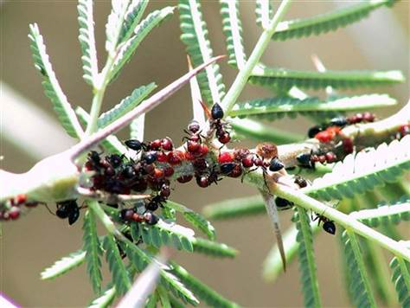
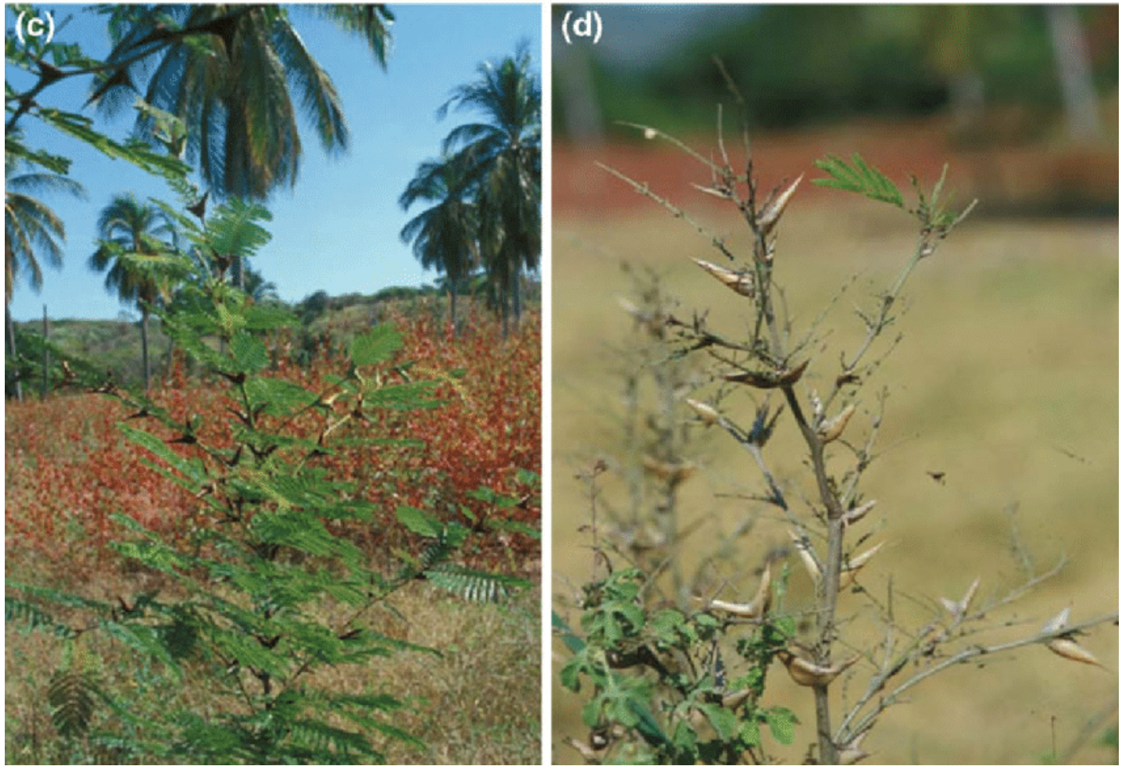
Ants and acacia trees
Indirect plant defense
Experiments involving removal of ants increases herbivory on leaves

Slide 30
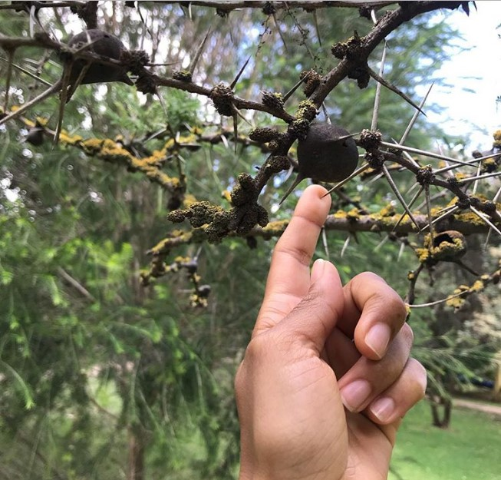
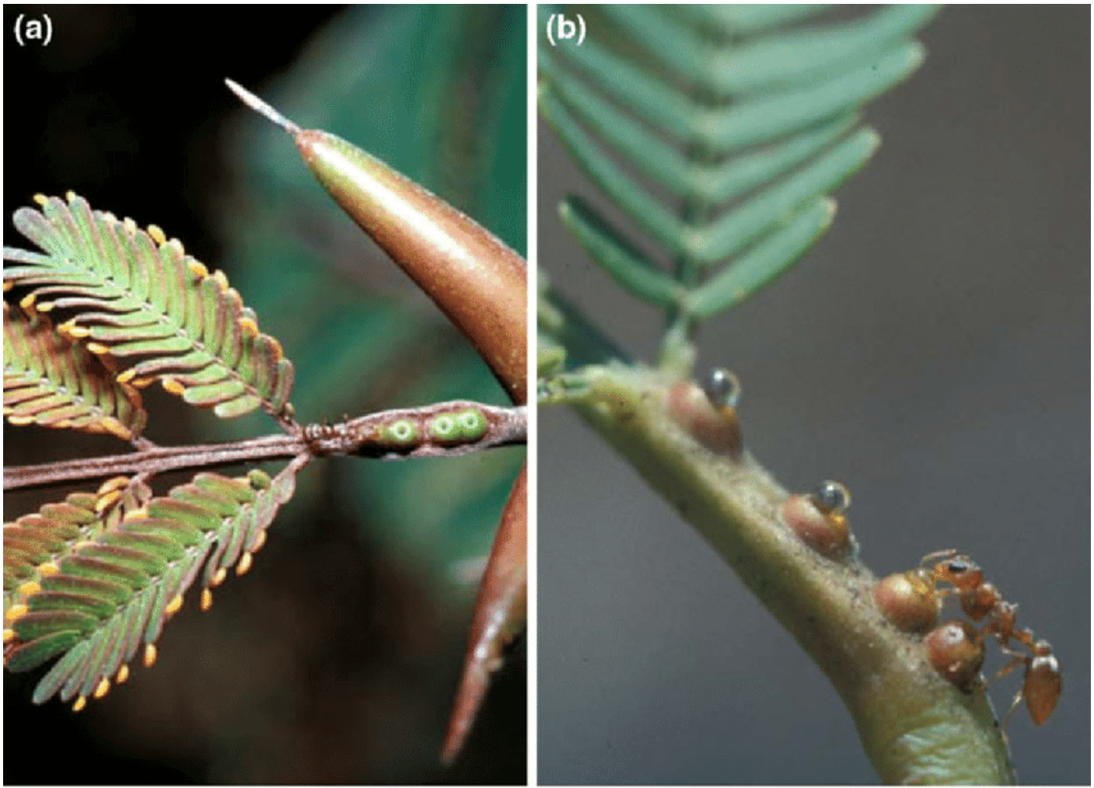
Ants and acacia trees
Acacia trees produce hollow thorns that ants use as nests
Acacia trees also produce nectar in special glands called extrafloral nectaries that provide food for the ants

Slide 31
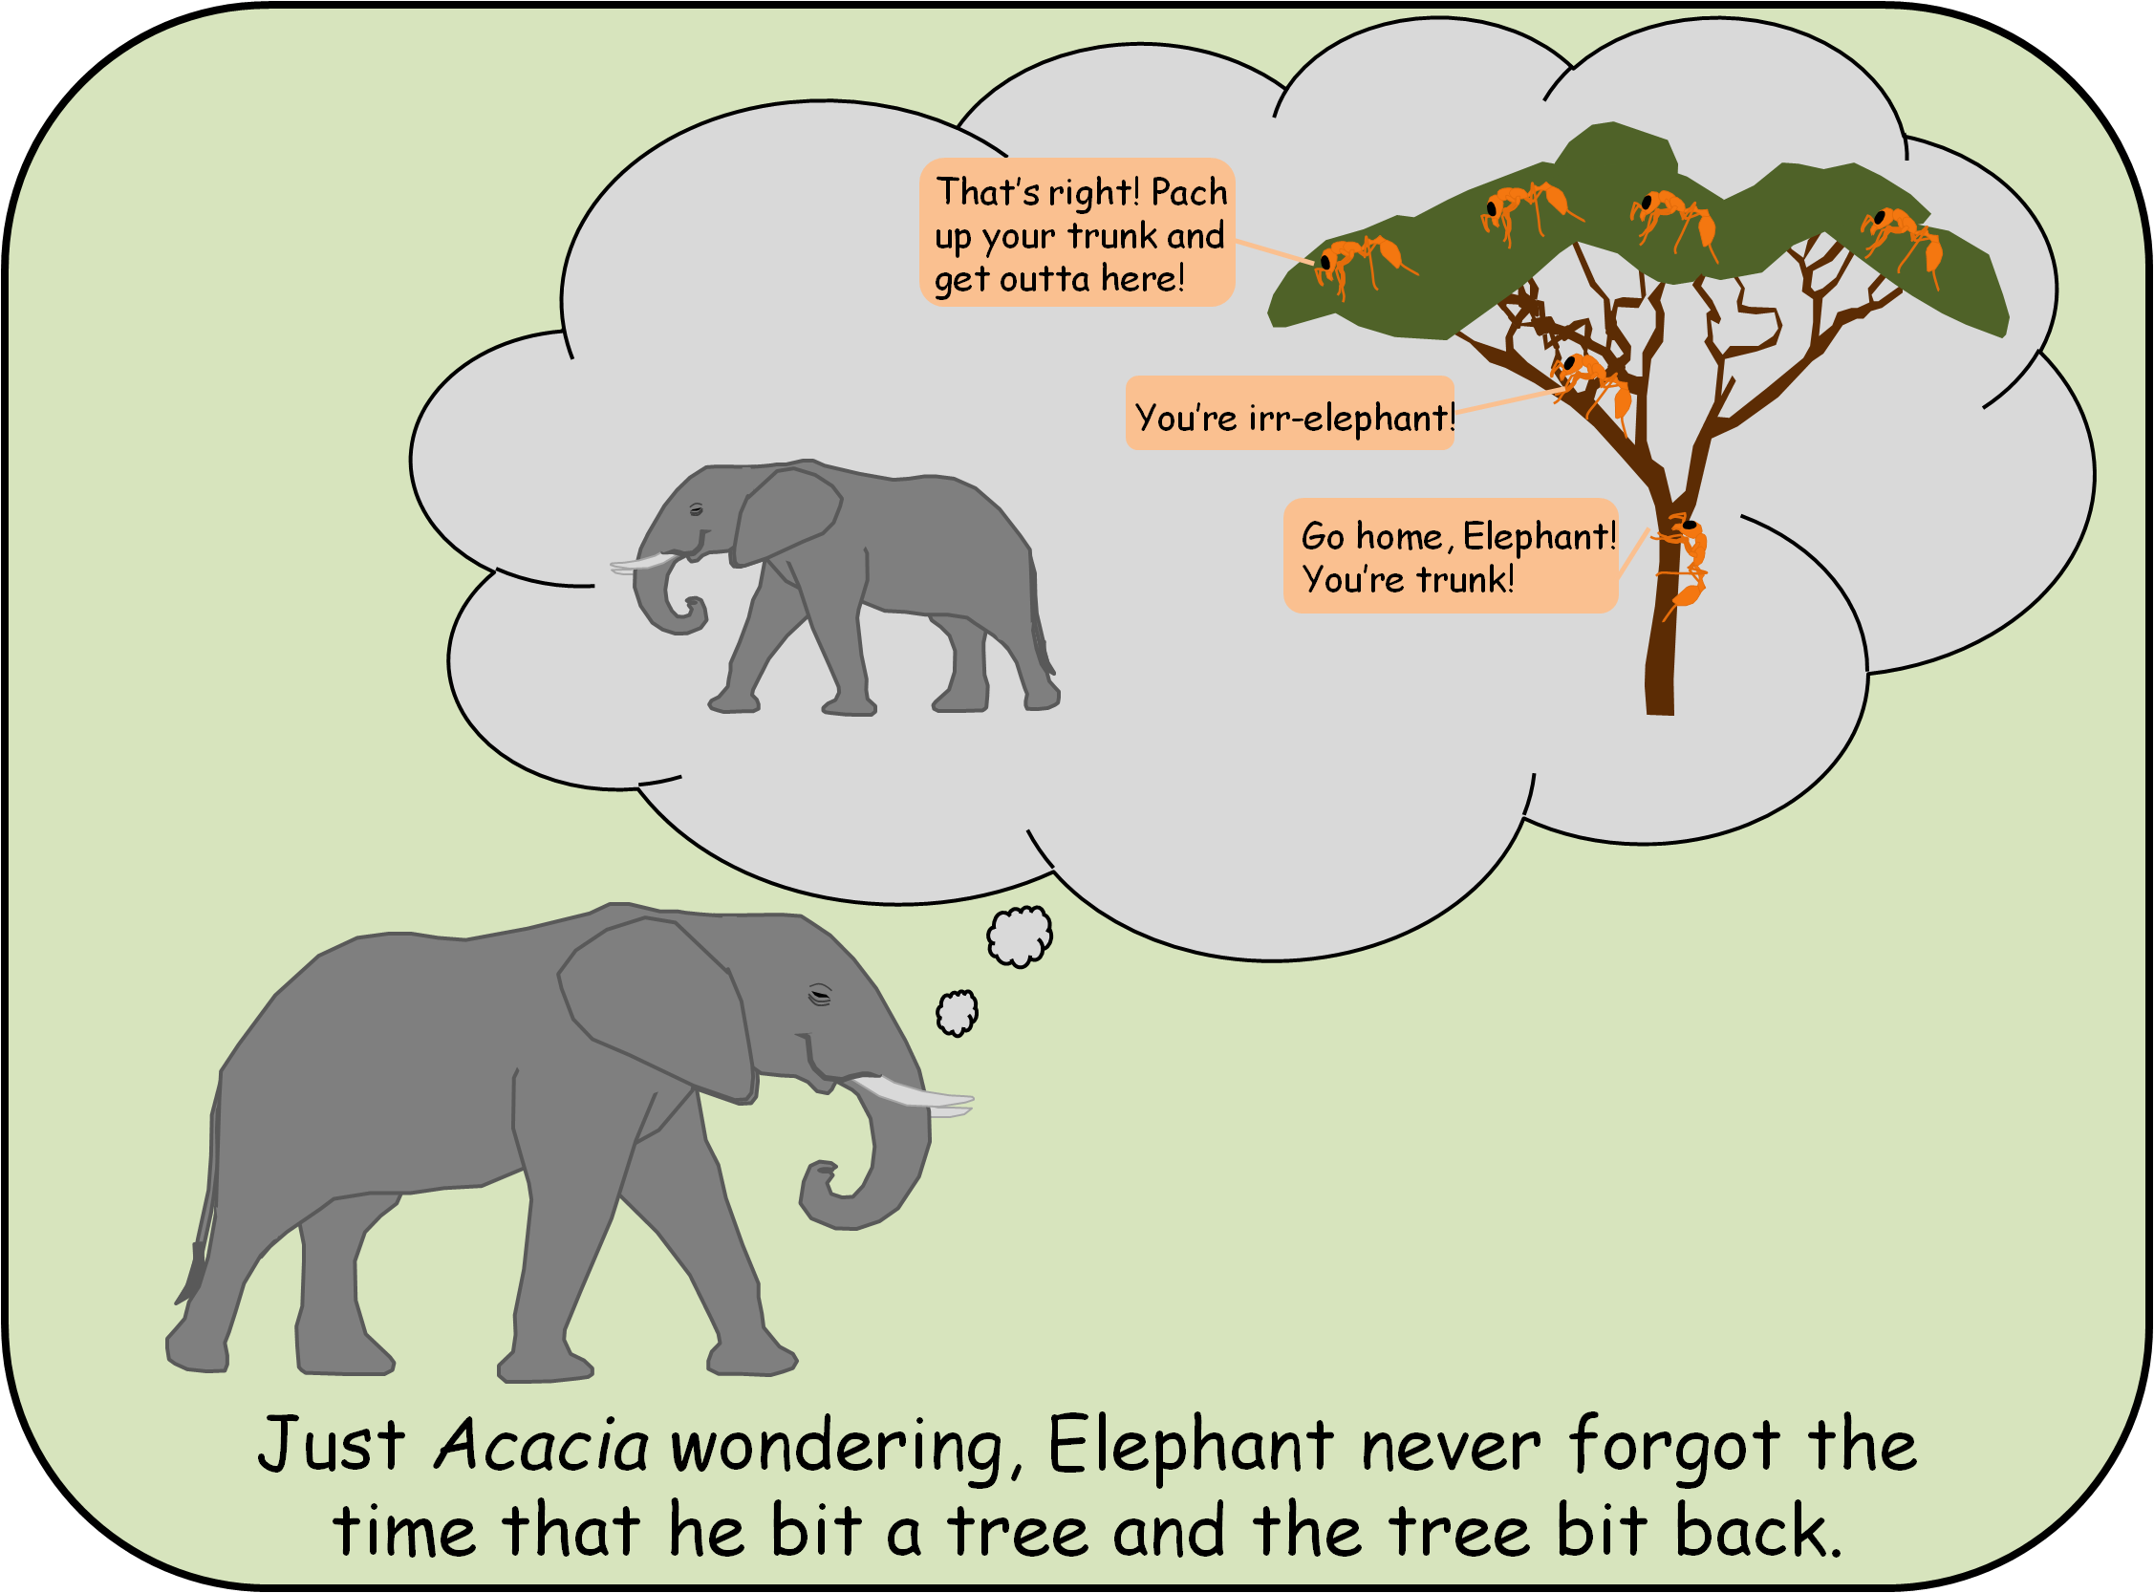
Some bad puns to remind you ants deter elephants from feeding on Acacia

Slide 32
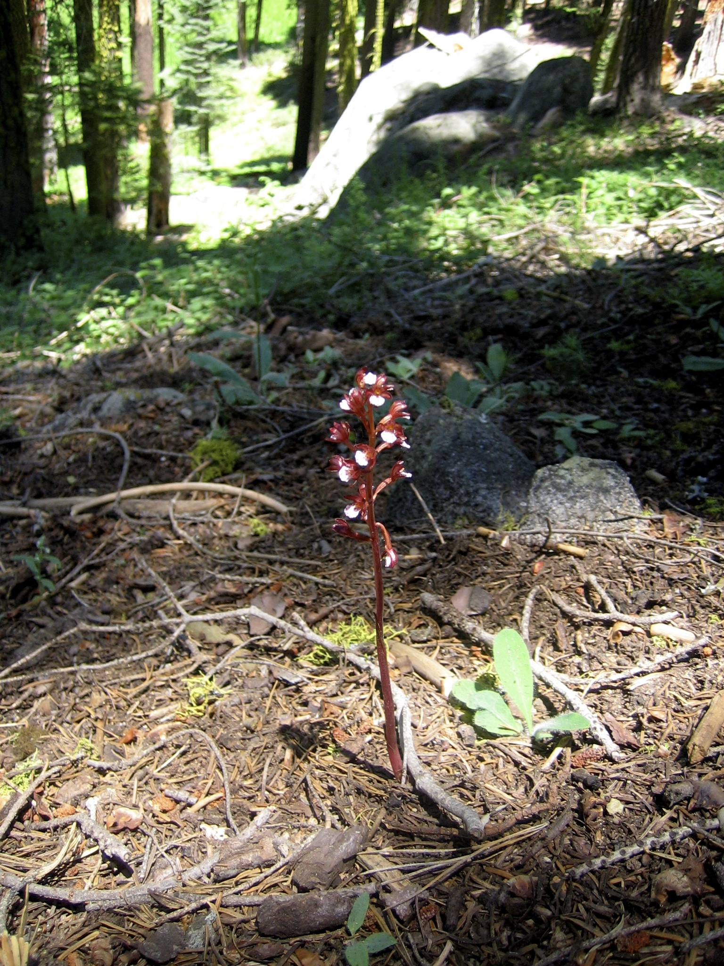
Commensalism
Interaction in which one species benefits from an association, and the other is unaffected
Many “textbook examples” of commensalism turn out to be mutualism with further study
Corallorhiza orchid needs bare acidic soil. Benefits from dense shade of canopy trees, does not affect them

Slide 33
Butterflies and caiman:
Another commensalism

